Slide 1
Mouse Actions, Javascript Executor
2025
Poornima

Slide 2
Mouse Actions
The Action class handles advanced user interactions in Selenium, like mouse movements, keyboard inputs, and context-click (right-click) actions.
It provides more control and flexibility in automated testing, allowing you to simulate complex user actions that can't be achieved with basic WebDriver commands.
✅ Steps to Perform Mouse Hover
Create an instance of Actions class.
Locate the target element.
Use .moveToElement(element).perform() to hover over it.
🔧 Example: Hover to Display Tooltip
// 1. Locate the element
WebElement hoverElement = driver.findElement(By.id("toolTipButton"));
// 2. Create Actions object and hover
Actions action = new Actions(driver);
action.moveToElement(hoverElement).perform();
🔍 Capturing Tooltip Text
Some tooltips are implemented using the title attribute.
String tooltipText = hoverElement.getAttribute("title");
System.out.println("Tooltip is: " + tooltipText);
build() - create an action
perform() - complete an action

Slide 3
Mouse Actions
doubleClick(WebElement element): Performs double click on the element
clickAndHold(WebElement element): Performs long click on the mouse without releasing it
dragAndDrop(Sourcelocator,Destinationlocator): Drags the element from one point and drops to another
moveToElement(WebElement element): Shifts the mouse pointer to the center of the element
contextClick(WebElement element): Performs right-click on the mouse

Slide 4
Drag and Drop
//WebElement on which drag and drop operation needs to be performed
WebElement fromElement = driver.findElement(By Locator of fromElement);
//WebElement to which the above object is dropped
WebElement toElement = driver.findElement(By Locator of toElement);
//Creating object of Actions class to build composite actions
Actions builder = new Actions(driver);
//Building a drag and drop action
Action dragAndDrop = builder.clickAndHold(fromElement)
.moveToElement(toElement)
.release(toElement)
.build();
//Performing the drag and drop action
dragAndDrop.perform();

Slide 5
Keyboard Actions
sendKeys(WebElement target, CharSequence... keys): Types a sequence of keys into a specified element. This can be used for standard characters or special keys defined in the Keys enum (e.g., Keys.ENTER, Keys.TAB, Keys.SPACE).
keyDown(WebElement target, CharSequence key): Performs a key press without releasing it. This is typically used with modifier keys (Control, Shift, Alt) to simulate key combinations.
keyUp(WebElement target, CharSequence key): Releases a pressed key. This is used in conjunction with keyDown to end a key combination action.
build(): Compiles the chained actions into a single, composite action (optional if using .perform() at the end of the chain).
perform(): Executes the stored actions.

Slide 6
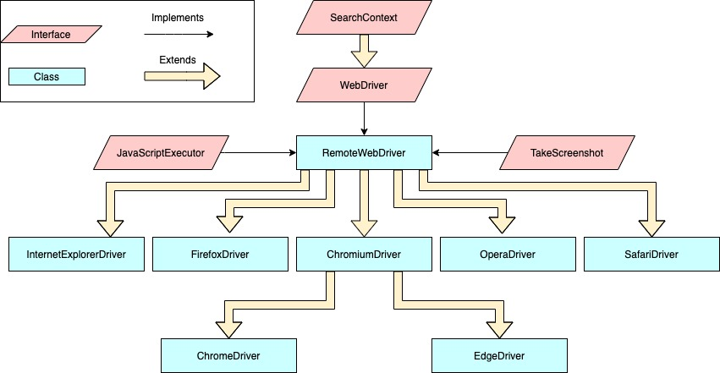
JavaScript Executor
JavaScriptExecutor is a specialized interface in Selenium WebDriver that allows you to execute JavaScript directly within the browser.
It acts as a bridge to interact with the Document Object Model (DOM) when standard Selenium commands—like .click() or .sendKeys()—fail due to hidden elements, complex overlays, or browser-specific limitations.

Slide 7
JavaScript Executor
executeScript(String script, Object... args): Executes synchronous JavaScript. The test script pauses until the JavaScript finishes executing.
To use this interface in Java, you must type-cast your WebDriver instance
// Import the package
import org.openqa.selenium.JavascriptExecutor;
// Type-cast the driver
JavascriptExecutor js = (JavascriptExecutor) driver;
// Execute a script
js.executeScript("window.scrollBy(0, 500)");

Slide 8
JavaScript Executor
JavaScriptExecutor is typically used as a fallback for the following scenarios:
Clicking Elements: Bypasses "Element Not Interactable" errors by triggering a click directly on the DOM.
js.executeScript("arguments[0].click();", webElement);
Scrolling: Enables precise scrolling to a specific element or coordinate.
js.executeScript("window.scrollTo(0, document.body.scrollHeight);"); (Scroll to bottom)
js.executeScript("arguments[0].scrollIntoView(true);", webElement); (Scroll to element)
js.executeScript("window.scrollBy(0,1500)", "");
Interacting with Hidden/Disabled Elements: Can change the value of hidden fields or enable disabled buttons.
js.executeScript("document.getElementById('id').value='text';");
Retrieving Page Data: Fetches information like the current URL, page title, or domain when standard methods are unavailable.
String title = js.executeScript("return document.title;").toString();
Handling Alerts: Generates custom browser alerts for testing.
js.executeScript("alert('Hello World!');");

Slide 9
TakeScreenshot Interface
In Selenium, the TakesScreenshot interface allows WebDriver (and even WebElements) to capture screenshots of the browser window or specific elements. It provides the method getScreenshotAs(OutputType<T> target) to save the screenshot in different formats like FILE, BASE64, or BYTES
What is TakesScreenshot?
Definition: A Selenium interface that indicates a driver or element can capture a screenshot.
Implemented by: Most browser drivers (e.g., ChromeDriver, FirefoxDriver, EdgeDriver, SafariDriver, RemoteWebDriver) and WebElement.
Purpose: Helps testers capture the state of the application during test execution for debugging, reporting, and validation.

Slide 10
TakeScreenshot Interface
✅ 1. Import Required Packages
import org.openqa.selenium.*;
import org.openqa.selenium.io.FileHandler;
import org.openqa.selenium.chrome.ChromeDriver;
import java.io.File;
import java.io.IOException;
✅ 2. Basic Screenshot Example
WebDriver driver = new ChromeDriver();
driver.get("https://example.com");
TakesScreenshot ts = (TakesScreenshot) driver;
File srcFile = ts.getScreenshotAs(OutputType.FILE);
File destFile = new File("screenshot.png");
try {
FileHandler.copy(srcFile, destFile);
System.out.println("Screenshot saved successfully.");
} catch (IOException e)
{
e.printStackTrace();
}
📁 Save with Timestamp (Dynamic Naming)
String timestamp = String.valueOf(System.currentTimeMillis());
File destFile = new File("screenshot_" + timestamp + ".png");

Slide 11
TakeScreenshot Interface
🔹 Capture Screenshot of a Specific Element
WebElement element = driver.findElement(By.id("logo"));
File src = element.getScreenshotAs(OutputType.FILE);
FileHandler.copy(src, new File("element.png"));
🔹 Capture Screenshot on Test Failure (TestNG Example)
public void takeScreenshot(WebDriver driver, String testName) {
TakesScreenshot ts = (TakesScreenshot) driver;
File src = ts.getScreenshotAs(OutputType.FILE);
File dest = new File("screenshots/" + testName + ".png");
try {
FileHandler.copy(src, dest);
} catch (IOException e) {
e.printStackTrace();
}
}
Call this method in @AfterMethod block if test fails.

